Slide 1
Sorting Algorithms Bubble, Selection & Insertion sort

Slide 2
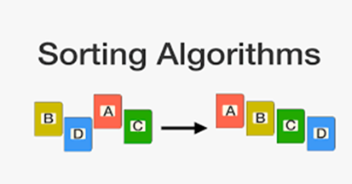
Sorting
Refers to the operation of arranging the data in some given order, such as increasing or decreasing.
For Example let A be a list of n numbers then:
A[1]<A[2]<A[3]<…………..A[n]

Slide 3
Sorting Techniques
Some of the sorting techniques used to arrange data are as follows :
Bubble sort
Selection sort
Insertion sort

Slide 4
Bubble sort
The general idea of the bubble sort is that each element is compared to all the elements in the data.
The bubble sort algorithm requires N-1 passes to sort N items of data.
The bubble sort is notoriously slow, but it is conceptually the simplest of the sorting algorithms.
The result of the first pass is that the largest item is in the last location of the array.
The result of the second pass is that the second largest item is in the second last location of the array.
etc.
After N passes, the entire array is sorted.

Slide 5
Bubble sort
The operation in each pass is as follows:
First, the values in the first two locations are compared. If necessary the values are exchanged, so that the largest one is last.
Then, the values in the second and third locations are compared. If necessary the values are exchanged, so that again the largest one is last.
This process repeats to the end of the array.
In effect, the largest item bubbles its way towards the top. It keeps on going until either it reaches the top and the pass ends.
If a complete pass is made without any exchanges being made, the data must already be sorted.

Slide 6
Bubble sort Example
25 | 15 | 20 | 2 | 17 | 1
15 | 20 | 2 | 17 | 1 | 25
15 | 2 | 17 | 1 | 20 | 25
2 | 15 | 1 | 17 | 20 | 25
2 | 1 | 15 | 17 | 20 | 25
1 | 2 | 15 | 17 | 20 | 25

Slide 7
Bubble sort Algorithm
Bubble sort (A)
{
for (pass=1;pass<n;pass++)
for (c=1;c<=(n-pass);c++)
if (A[c]>A[c+1])
{
swap (A[c], A[c+1])
}
}

Slide 8
Bubble sort: Example
Pass 1 : 25 15 10 2 17 1
15 25 20 2 17 1
15 20 25 2 17 1
15 20 2 25 17 1
15 20 2 17 25 1
15 20 2 17 1 25

Slide 9
Bubble sort: Example
Pass2: 15 20 2 17 1 25
15 20 2 17 1 25
15 2 20 17 1 25
15 2 17 20 1 25
15 2 17 1 20 25
15 2 17 1 20 25
Pass 3: 15 2 17 1 20 25
2 15 17 1 20 25
2 15 17 1 20 25
2 15 1 17 20 25
2 15 1 17 20 25

Slide 10
Bubble sort: Example
Pass 4 : 2 15 1 17 20 25
2 15 1 17 20 25
2 1 15 17 20 25
2 1 15 17 20 25
Pass 5: 2 1 15 17 20 25
1 2 15 17 20 25
1 2 15 17 20 25
1 2 15 17 20 25
1 2 15 17 20 25

Slide 11
Complexity of Bubble sort
Time consuming operations
compares, swaps.
Compares
a for loop embedded inside a for loop
(n-1)+(n-2)+(n-3) …+1 , or O(n²)
Swaps
inside a conditional -> #swaps data dependent !!
Best Case 0, or O(1)
Worst Case (n-1)+(n-2)+(n-3) …+1 , or O(n²)
Average Case O(n²)

Slide 12
Selection Sort
The general idea of the selection sort is that for each slot, find the element that belongs there.
The selection sort improves on the bubble sort by reducing the number of swaps.
The number of comparisons remains the same that is to sort N items you make N-1 passes through them.

Slide 13
Selection Sort
The operation in each pass is as follows:
First find the smallest element in the list and swap it with the element in the first position.
On the second pass you scan through just the first N-1 entries. Then find the second smallest element in the list and swap it in the element in the second position.
This process is repeated, with one item being placed in its correct location each time.
After N-1 passes, the entire collection of data is sorted.

Slide 14
Selection Sort-Example
Suppose the following numbers are stored in an array A:
77 | 33 | 44 | 11 | 88 | 22 | 66 | 55
Pass 1: 77,33,44,11,88,22,66,55
Pass 1: 77,33,44,11,88,22,66,55
Pass 2: 11,33,44,77,88,22,66,55
Pass 3: 11,22,44,77,88,33,66,55
Pass 4: 11,22,33,77,88,44,66,55
Pass 5: 11,22,33,44,88,77,66,55
Pass 6: 11,22,33,44,55,77,66,88
Pass 7: 11,22,33,44,55,66,77,88

Slide 15
Selection sort Algorithm
Selection sort (A)
{
for (i=0;i<=n-1;i++)
{ min=i;
for (j=i+1;j<n;j++)
{
if (A[j]<A[min])
min=j;
}
swap (A[min],A[i])
}
}

Slide 16
Complexity of Selection Sort
Best Case | Worst Case
O(n²) | O(n²)

Slide 17
Insertion Sort
Idea: like sorting a hand of playing cards
Start with an empty left hand and the cards facing down on the table.
Remove one card at a time from the table, and insert it into the correct position in the left hand
compare it with each of the cards already in the hand, from right to left
The cards held in the left hand are sorted
these cards were originally the top cards of the pile on the table

Slide 18
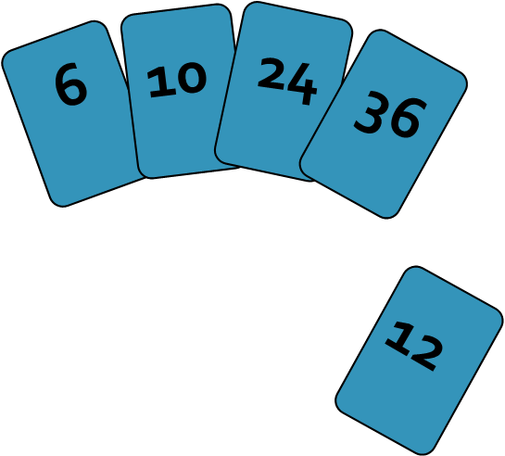
Insertion Sort
To insert 12, we need to make room for it by moving first 36 and then 24.

Slide 19
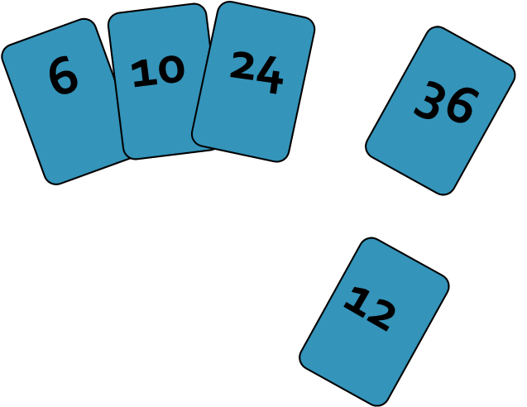
Insertion Sort

Slide 20
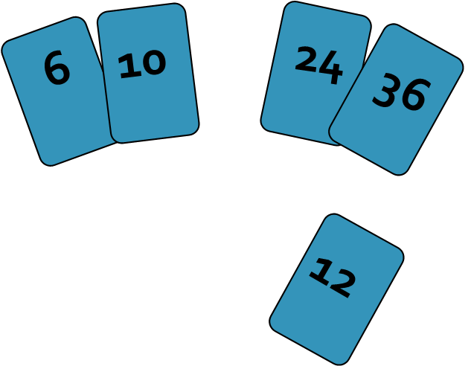
Insertion Sort

Slide 21
Insertion Sort
input array
2 4 6 1 3
at each iteration, the array is divided in two sub-arrays:

Slide 22
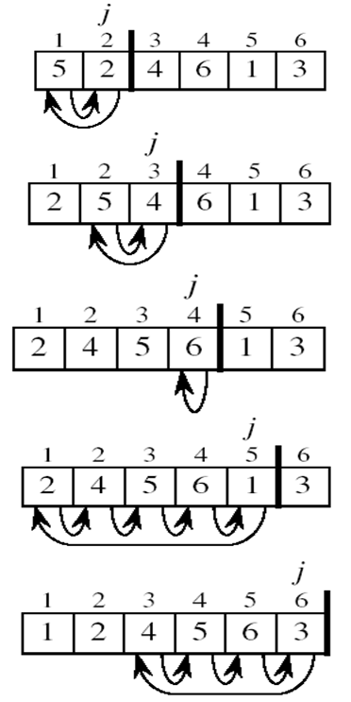
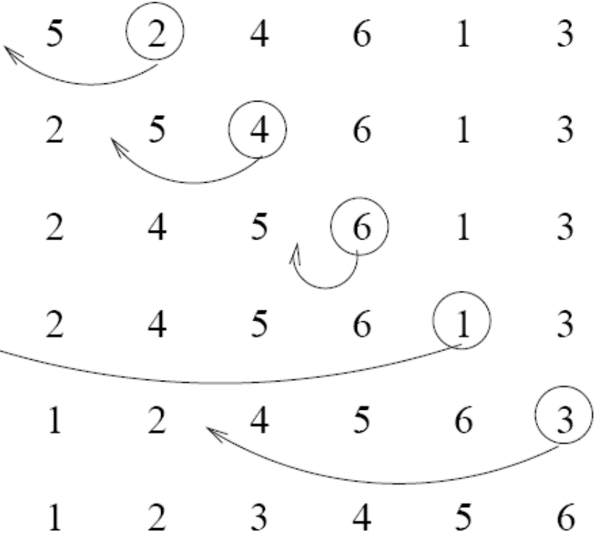
Insertion Sort

Slide 23
Insertion Sort
The operation in each pass is as follows:
A[1 ] by itself is sorted.
A[2] is inserted either before A[1] or after A[1] so that A[1] and A[2] are sorted.
A[N] is inserted into its proper place in A[1],A[2]…A[N-1] so that A[1],A[2]…A[N] is sorted.

Slide 24
Insertion Sort
Suppose the following numbers are stored in an array A:
Pass 1:77,33,44,11,88,22,66,55
Pass 2:77,33,44,11,88,22,66,55
Pass 3:33,77,44,11,88,22,66,55
Pass 4:33,44,77,11,88,22,66,55
Pass 5:11,33,44,77,88,22,66,55
Pass 6:11,22,33,44,77,88,66,55
Pass 7:11,22,33,44,66,77,88,55
Pass 8:11,22,33,44,55,66,77,88
77 | 33 | 44 | 11 | 88 | 22 | 66 | 55

Slide 25
Insertion Sort Algorithm
Insertion sort (A)
{
for (i=1;i<=n-1;i++)
{ key=A[i]
j=i-1;
while (j>=0 && A[j]>key)
{
A[j+1]=A[j];
j--;
}
A[j+1]=key;
}
}

Slide 26
Complexity of Insertion Sort
Best Case | Worst Case
O(n²) | O(n²)

Slide 27
Questions & answers

